Slide 1
Applications
Emergencies
Business
Replacement of wired networks
Infotainment and more
Location dependent services
Follow-on services-automatic call forwarding, email reply.
Location aware services-printer, Fax.
Privacy-privacy policies available.
Information services-pull services, push services.
Support services- Caches, State information( Transaction time out, session expired, Congratulations etc)

Slide 2
Frequencies for radio transmission
λ = c/f

Slide 3
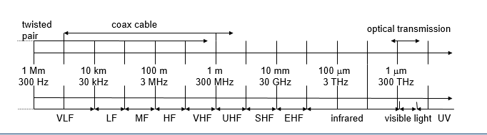
VLF = Very Low Frequency UHF = Ultra High Frequency
LF = Low Frequency SHF = Super High Frequency
MF = Medium Frequency EHF = Extra High Frequency
HF = High Frequency UV = Ultraviolet Light
VHF = Very High Frequency
Frequency and wave length
λ = c/f
wave length λ, speed of light c ≅ 3x10⁸m/s, frequency f

Slide 4
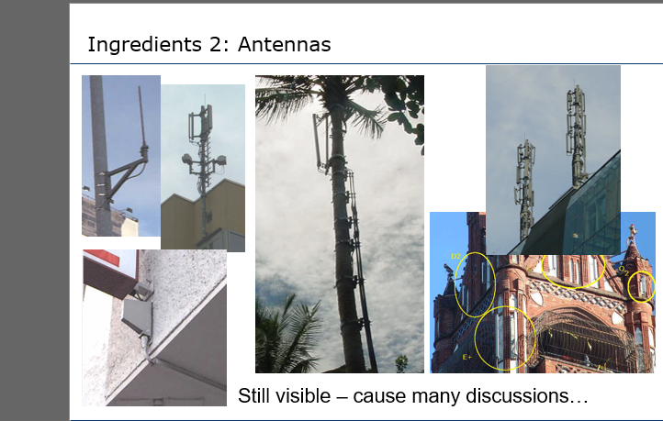

Slide 5
Antenna
couple the energy from the transmitter to the outside world and, in reverse, from the outside world to the receiver.
Antennas couple electromagnetic energy to and from space to and from a wire or coaxial cable (or any other appropriate conductor)

Slide 6
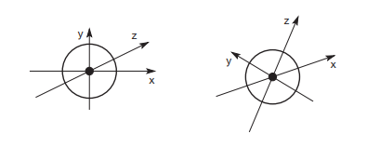


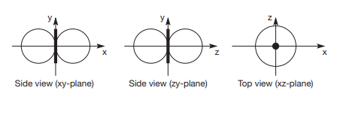
Isotropic –
Simple antenna-Hertzian dipole
Marconi antenna-
Radiation Pattern of simple antenna
Omnidirectional

Slide 7
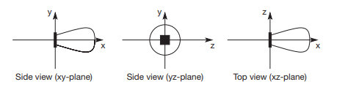
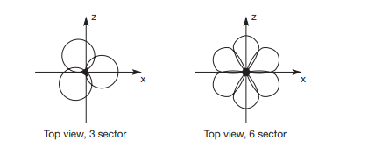
Directional antenna
Sectorized antenna

Slide 8
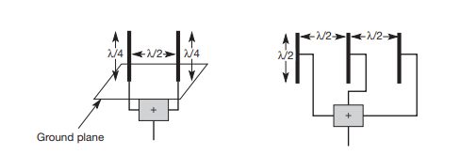
Diversity antenna

Slide 9
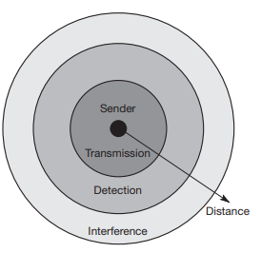
Signal Propagation-
Transmission range
communication possible
low error rate
Detection range
detection of the signal possible
no communication possible
Interference range
signal may not be detected
signal adds to the background noise

Slide 10
Path loss of radio signals
line-of-sight (LOS).
free space loss- even if no matter exists.
The received power Pr is proportional to with d being the distance between sender and receiver (inverse square law).
signal travels away from the sender at the speed of light as a wave with a spherical shape. If there is no obstacle, the sphere continuously grows with the sending energy equally distributed over the sphere’s surface. This surface area s grows with the increasing distance d from the center according to the equation

Slide 11
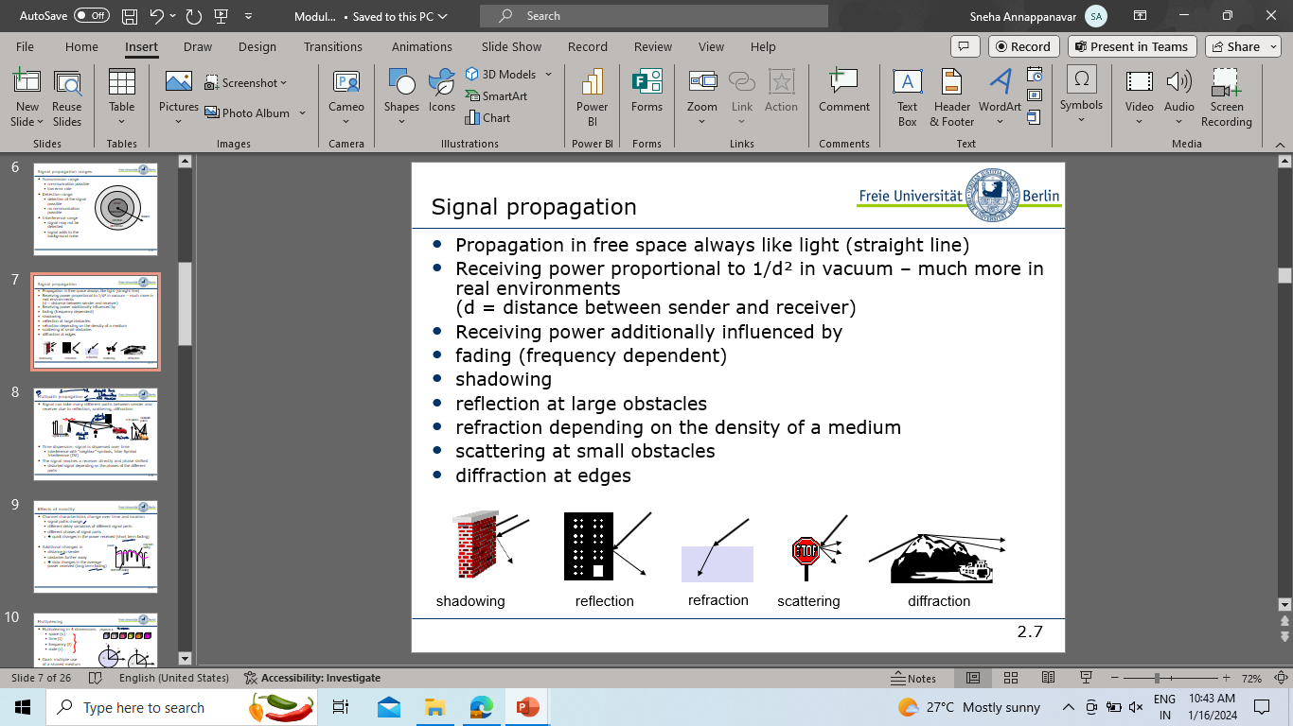
Attenuation
Loss of path of signal due to external factors through atmosphere- signals travel through air, rain, snow, fog, dust particles, smog etc.

Slide 12
Shadowing- for large objects
Reflection-If an object is large compared to the wavelength of the signal.
Refraction-This effect occurs because the velocity of the electromagnetic waves depends on the density of the medium through which it travels.
Scattering- If the size of an obstacle is in the order of the wavelength or less, then waves can be scattered.
Diffraction- Radio waves will be deflected at an edge and propagate in different directions.

Slide 13
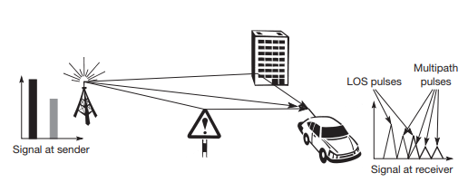
Multipath Propagation Due to the finite speed of light, signals travelling along different paths with different lengths arrive at the receiver at different times. This effect (caused by multi-path propagation) is called delay spread: the original signal is spread due to different delays of parts of the signal. -Training sequence, equalizer
Time dispersion: signal is dispersed over time
interference with “neighbor” symbols, Inter Symbol Interference (ISI)- Training Sequence, Equalizer.

Slide 14
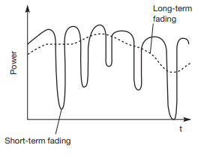
Effects of Mobility
Channel characteristics change over time and location
signal paths change
different delay variations of different signal parts
different phases of signal parts
➔ quick changes in the power received (short term fading)
Additional changes in
distance to sender
obstacles further away
➔ slow changes in the average power received (long term fading)

Slide 15
Multiplexing
Multiplexing in 4 dimensions
space (s_{i})
time (t)
frequency (f)
code (c)
Goal: multiple use of a shared medium
Important: guard spaces needed!

Slide 16
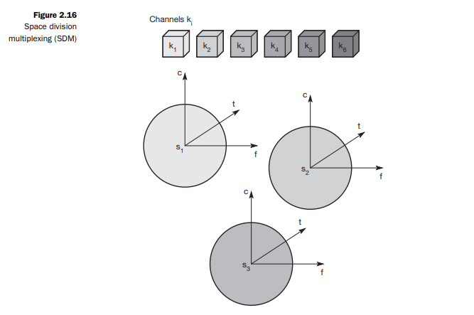
Space Division Multiplexing

Slide 17
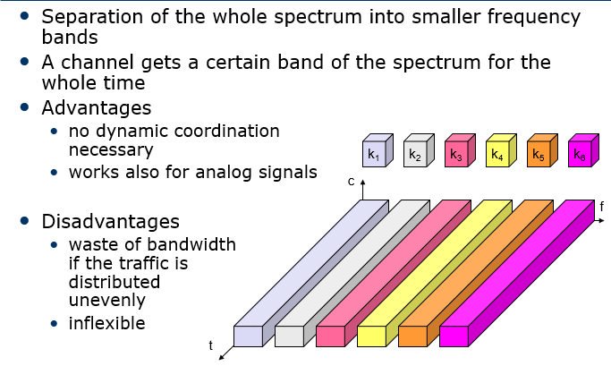
Frequency Multiplexing

Slide 18
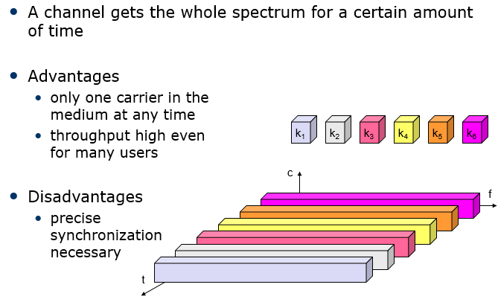
Time Multiplex

Slide 19
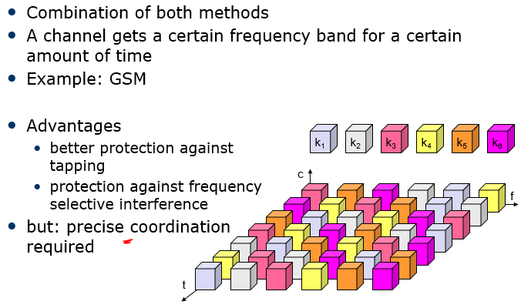
Time and Frequency

Slide 20
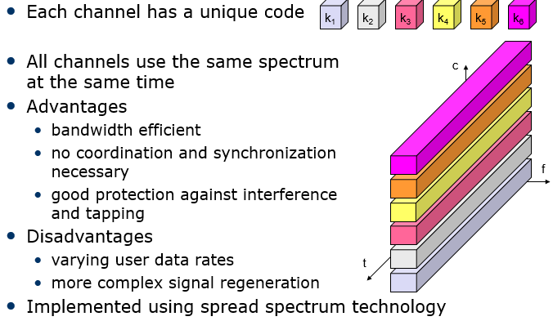
Code Multiplex

Slide 21
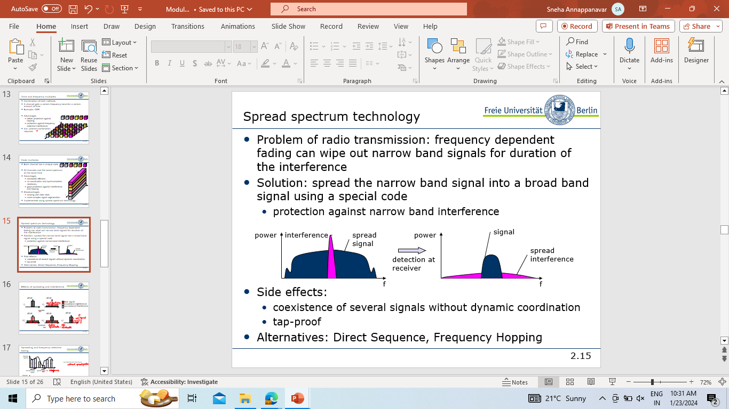
Spread Spectrum

Slide 22
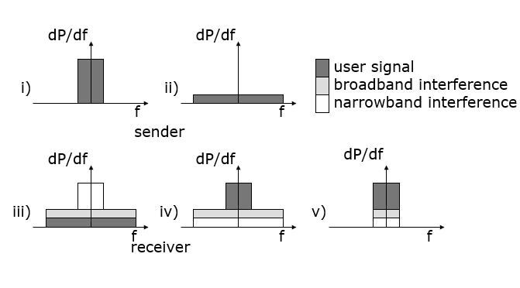

Slide 23
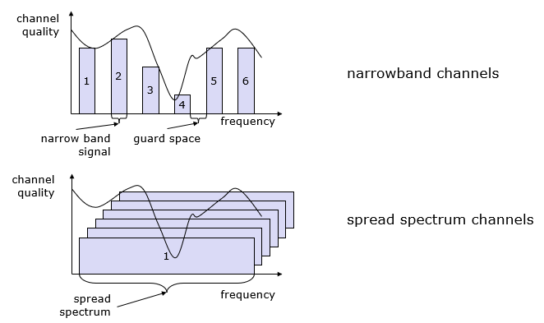

Slide 24
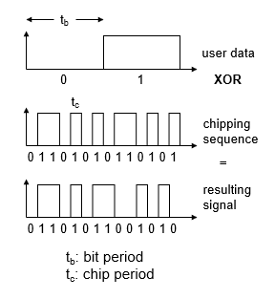
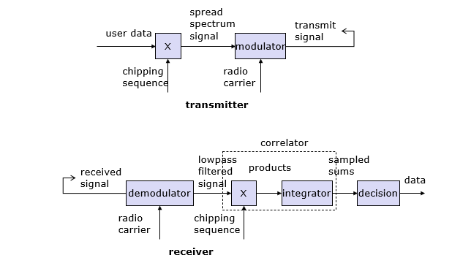
Direct Sequence Spread Spectrum(DSSS)

Slide 25
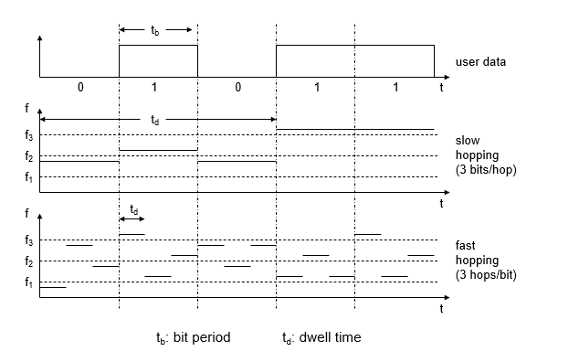
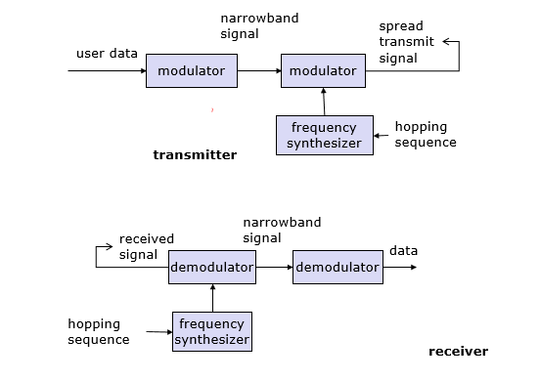
Frequency Hopping Spread Spectrum(FHSS)

Slide 26
Cellular Structure
Cell
Advantages of cell structures
higher capacity, higher number of users
less transmission power needed
more robust, decentralized
base station deals with interference, transmission area etc. locally
Problems
fixed network needed for the base stations
handover (changing from one cell to another) necessary
interference with other cells
Cell sizes from some 100 m in cities to, e.g., 35 km on the country side (GSM) - even less for higher frequencies

Slide 27
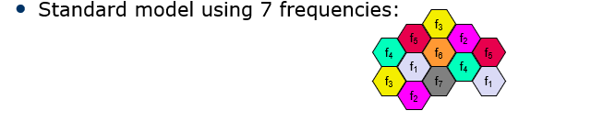
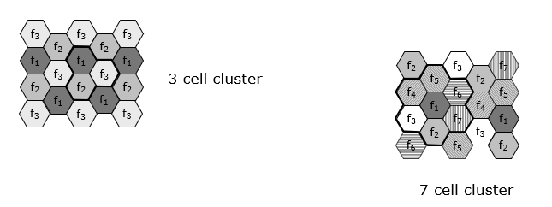
Frequency Planning

